Slide 1
HIVE ASSIGNMENT
BY LOGESHWARAN V

Slide 2
Problem Statement
New York City is a thriving metropolis, and like most other cities of its size, one of the biggest problems faced by its residents is the lack of parking space. The classic combination of a huge number of cars and cramped geography is the exact recipe that leads to a large number of parking tickets.
In an attempt to scientifically analyze this phenomenon, the NYC Police Department regularly collects data related to parking tickets. This data is made available by the NYC Open Data portal. Your job is to try and perform some analysis on this data in order to answer the questions that follow.

Slide 3
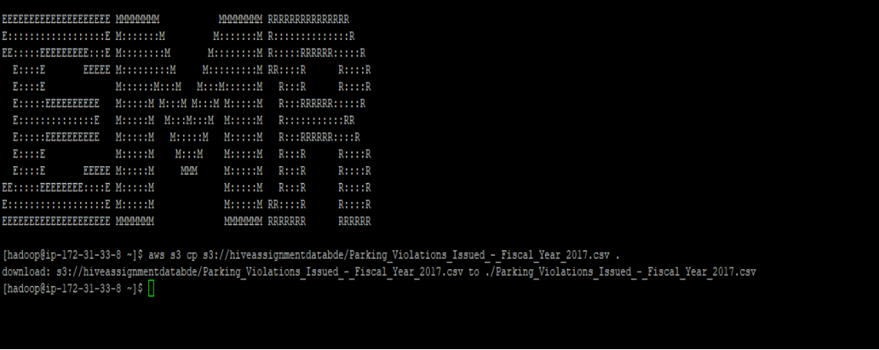
Copy Data to Hadoop
aws s3 cp s3://hiveassignmentdatabde/Parking_Violations_Issued_- _Fiscal_Year_2017.csv .

Slide 4
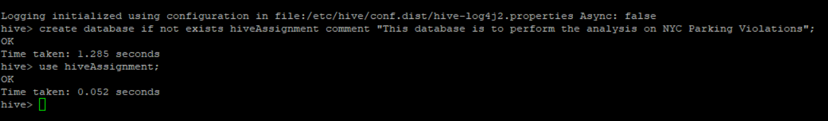
Creating and using the database
Create database:
create database if not exists hiveAssignment comment "This database is to perform the analysis on NYC Parking Violations";
Use database:
use hiveAssignment;

Slide 5
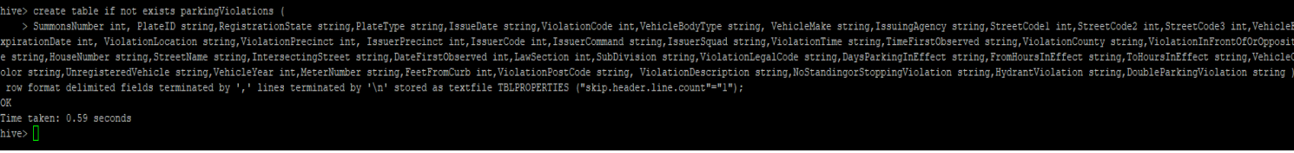
Creating the table
create table if not exists parkingViolations ( SummonsNumber int, PlateID string,RegistrationState string,PlateType string,IssueDate string,ViolationCode int,VehicleBodyType string, VehicleMake string,IssuingAgency string,StreetCode1 int,StreetCode2 int,StreetCode3 int,VehicleExpirationDate int, ViolationLocation string,ViolationPrecinct int, IssuerPrecinct int,IssuerCode int,IssuerCommand string,IssuerSquad string,ViolationTime string,TimeFirstObserved string,ViolationCounty string,ViolationInFrontOfOrOpposite string,HouseNumber string,StreetName string,IntersectingStreet string,DateFirstObserved int,LawSection int,SubDivision string,ViolationLegalCode string,DaysParkingInEffect string,FromHoursInEffect string,ToHoursInEffect string,VehicleColor string,UnregisteredVehicle string,VehicleYear int,MeterNumber string,FeetFromCurb int,ViolationPostCode string, ViolationDescription string,NoStandingorStoppingViolation string,HydrantViolation string,DoubleParkingViolation string ) row format delimited fields terminated by ',' lines terminated by '\n' stored as textfile TBLPROPERTIES ("skip.header.line.count"="1");

Slide 6
Loading the data into table
Load data to table:
load data local inpath '/home/hadoop/Parking_Violations_Issued_- _Fiscal_Year_2017.csv' into table parkingViolations ;

Slide 7

Enabling Dynamic Partitioning
set hive.exec.dynamic.partition=true;
set hive.exec.dynamic.partition.mode= nonstring;

Slide 8
Part -1 Examine the data:
Create a table with year as partition:
create table if not exists parkingViolations_partitioned ( SummonsNumber int, PlateID string,RegistrationState string,PlateType string,IssueDate string,ViolationCode int,VehicleBodyType string,VehicleMake string,IssuingAgency string,StreetCode1 int,StreetCode2 int,StreetCode3 int,VehicleExpirationDate int, ViolationLocation string,ViolationPrecinct int,IssuerPrecinct int,IssuerCode int,IssuerCommand string,IssuerSquad string,ViolationTime string,TimeFirstObserved string,ViolationCounty string,ViolationInFrontOfOrOpposite string,HouseNumber string,StreetName string,IntersectingStreet string,DateFirstObserved int,LawSection int,SubDivision string,ViolationLegalCode string,DaysParkingInEffect string, FromHoursInEffect string,ToHoursInEffect string,VehicleColor string,UnregisteredVehicle string,VehicleYear int,MeterNumber string,FeetFromCurb int,ViolationPostCode string, ViolationDescription string,NoStandingorStoppingViolation string,HydrantViolation string,DoubleParkingViolation string,month int, hour int ) partitioned by ( year int ) row format delimited fields terminated by ',' lines terminated by '\n' stored as textfile TBLPROPERTIES ("skip.header.line.count"="1");

Slide 9
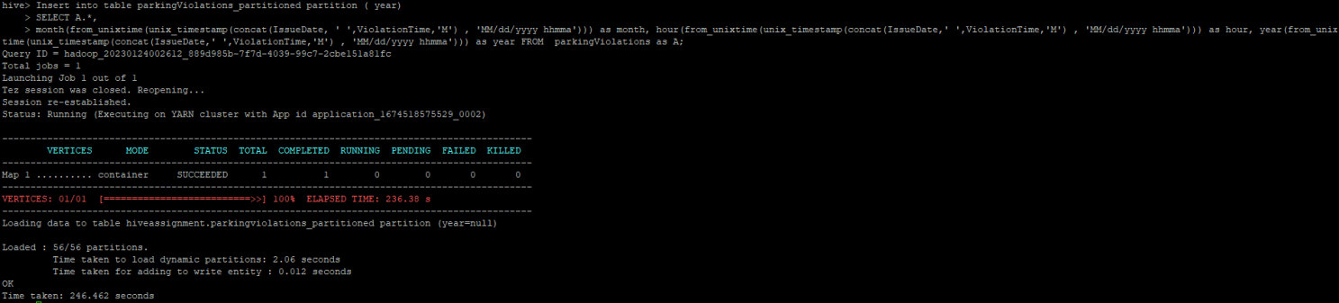
Load data into table with year as partition:
Insert into table parkingViolations_partitioned partition ( year) SELECT A.*, month(from_unixtime(unix_timestamp(concat(IssueDate, ' ',ViolationTime,'M') , 'MM/dd/yyyy hhmma'))) as month, hour(from_unixtime(unix_timestamp(concat(IssueDate,' ',ViolationTime,'M') , 'MM/dd/yyyy hhmma'))) as hour, year(from_unixtime(unix_timestamp(concat(IssueDate,' ',ViolationTime,'M') , 'MM/dd/yyyy hhmma'))) as year FROM parkingViolations as A;

Slide 10
Q1. Find the total number of tickets for the year.
Query :
Select count(*) as total_num_of_tickets from parkingViolations_partitioned where year = 2017;
Ans:
5431842

Slide 11
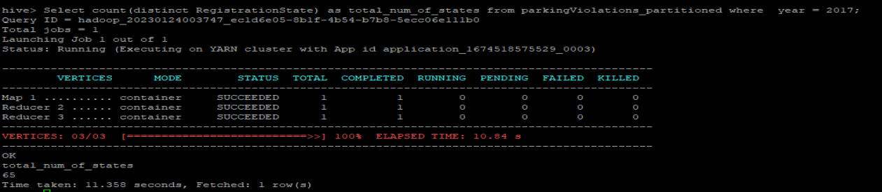
Q2. Find out the total number of states to which the cars with tickets belong. The count of states is mandatory here; providing the exact list of states is optional.
Query :
Select count(distinct RegistrationState) as total_num_of_states from parkingViolations_partitioned where year = 2017;
Answer:
65

Slide 12
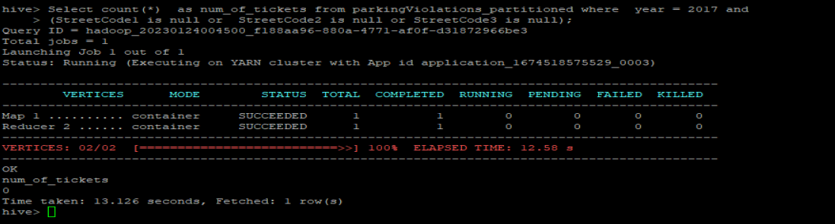
Q3. Some parking tickets don’t have addresses on them, which is a cause for concern. Find out the number of such tickets which have no addresses. (i.e. tickets where one of the Street Codes, i.e. "Street Code 1" or "Street Code 2" or "Street Code 3" is empty)
Query:
Select count(*) as num_of_tickets from parkingViolations_partitioned where year = 2017 and (StreetCode1 is null or StreetCode2 is null or StreetCode3 is null);
Answer:
For year 2017, there are no tickets which don’t have address.

Slide 13
Part-II: Aggregation tasks

Slide 14
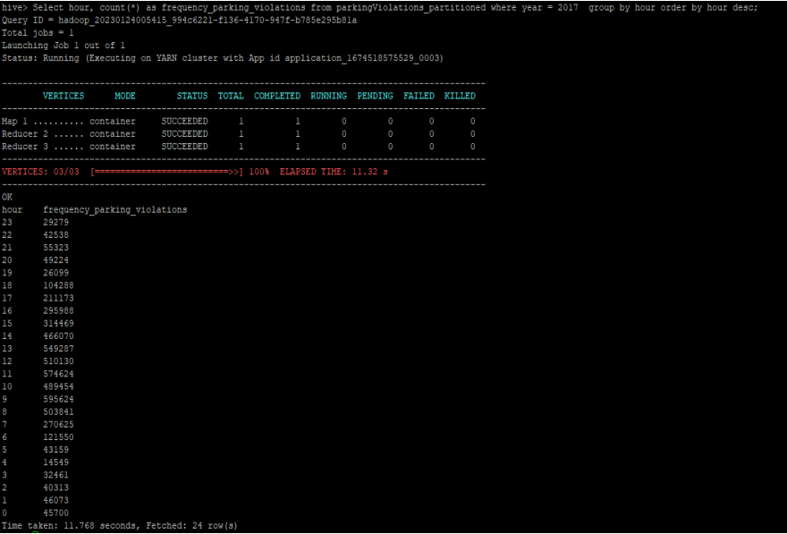
Q1. Find out the frequency of parking violations across different times of the day: The Violation Time field is specified in a strange format. Find a way to make this into a time attribute that you can use to divide into groups.
Query:
Select hour, count(*) as frequency_parking_violations from parkingViolations_partitioned where year = 2017 group by hour order by hour desc;

Slide 15
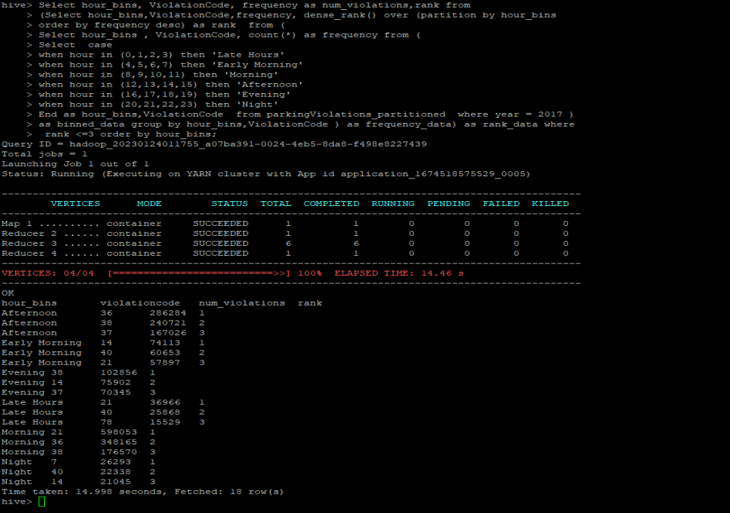
Q2. Divide 24 hours into six equal discrete bins of time. The intervals you choose are at your discretion. For each of these groups, find the 3 most commonly occurring violations.
Query:
Select hour_bins, ViolationCode, frequency as num_violations,rank from (Select hour_bins,ViolationCode,frequency, dense_rank() over (partition by hour_bins order by frequency desc) as rank from ( Select hour_bins , ViolationCode, count(*) as frequency from ( Select case when hour in (0,1,2,3) then 'Late Hours' when hour in (4,5,6,7) then 'Early Morning' when hour in (8,9,10,11) then 'Morning' when hour in (12,13,14,15) then 'Afternoon' when hour in (16,17,18,19) then 'Evening' when hour in (20,21,22,23) then 'Night' End as hour_bins,ViolationCode from parkingViolations_partitioned where year = 2017 ) as binned_data group by hour_bins,ViolationCode ) as frequency_data) as rank_data where rank <=3 order by hour_bins;

Slide 16
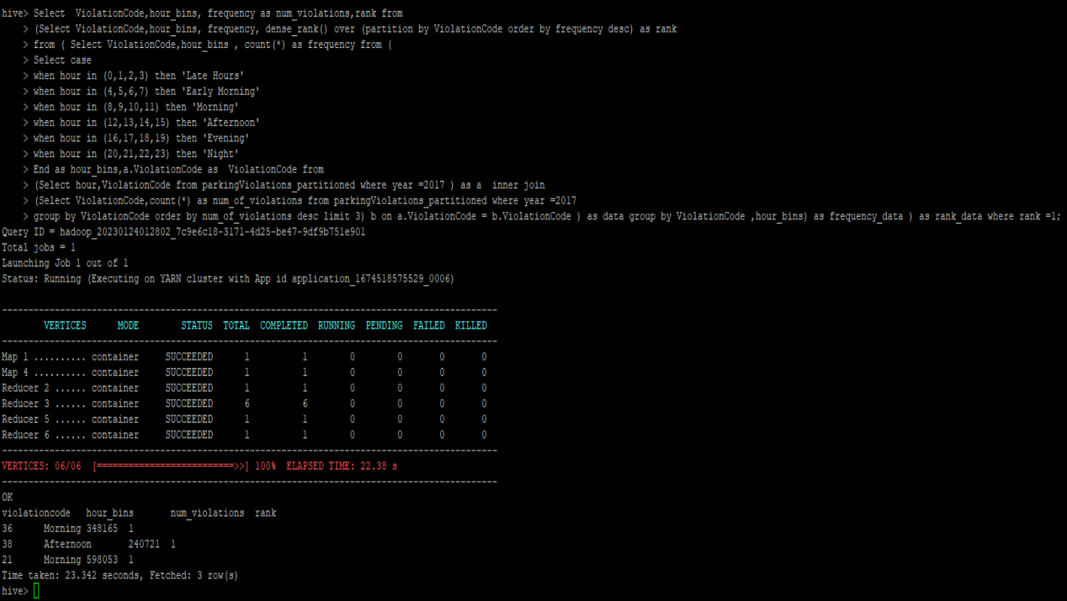
Q3. Now, try another direction. For the 3 most commonly occurring violation codes, find the most common times of day (in terms of the bins from the previous part).
Query:
Select ViolationCode,hour_bins, frequency as num_violations,rank from (Select ViolationCode,hour_bins, frequency, dense_rank() over (partition by ViolationCode order by frequency desc) as rank from ( Select ViolationCode,hour_bins, count(*) as frequency from ( Select case when hour in (0,1,2,3) then 'Late Hours' when hour in (4,5,6,7) then 'Early Morning' when hour in (8,9,10,11) then 'Morning' when hour in (12,13,14,15) then 'Afternoon' when hour in (16,17,18,19) then 'Evening' when hour in (20,21,22,23) then 'Night' End as hour_bins,a.ViolationCode as ViolationCode from (Select hour,ViolationCode from parkingViolations_partitioned where year =2017 ) as a inner join (Select ViolationCode,count(*) as num_of_violations from parkingViolations_partitioned where year =2017 group by ViolationCode order by num_of_violations desc limit 3) b on a.ViolationCode = b.ViolationCode ) as data group by ViolationCode ,hour_bins) as frequency_data ) as rank_data where rank =1;

Slide 17
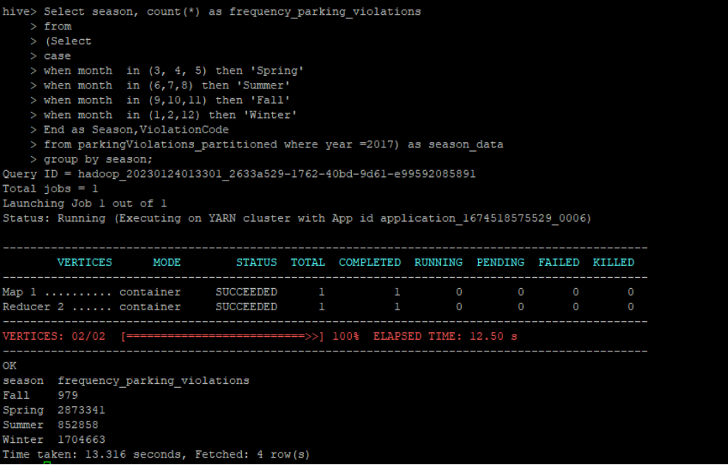
Q4.1: First, divide the year into seasons, and find the frequencies of tickets for each season.
Query:
Select season, count(*) as frequency_parking_violations from (Select case when month in (3, 4, 5) then 'Spring' when month in (6,7,8) then 'Summer' when month in (9,10,11) then 'Fall' when month in (1,2,12) then 'Winter' End as Season,ViolationCode from parkingViolations_partitioned where year =2017) as season_data group by season;

Slide 18
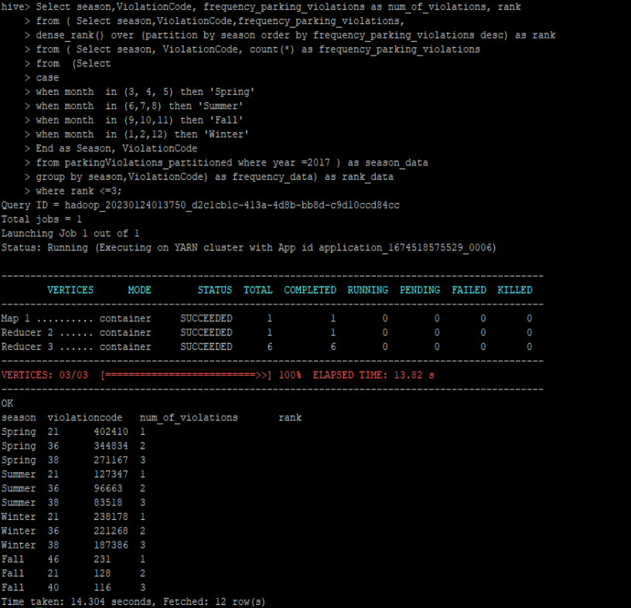
Q4.2: find the 3 most common violations for each of these seasons.
Query:
Select season,ViolationCode, frequency_parking_violations as num_of_violations, rank from ( Select season,ViolationCode,frequency_parking_violations, dense_rank() over (partition by season order by frequency_parking_violations desc) as rank from ( Select season, ViolationCode, count(*) as frequency_parking_violations from (Select case when month in (3, 4, 5) then 'Spring' when month in (6,7,8) then 'Summer' when month in (9,10,11) then 'Fall' when month in (1,2,12) then 'Winter' End as Season, ViolationCode from parkingViolations_partitioned where year =2017 ) as season_data group by season,ViolationCode) as frequency_data) as rank_data where rank <=3;

Slide 19
Thank You

